Slide 1
CLEAN UP PAWTUCKET AND CENTRAL FALLS
EARTH DAY
Lamisa and Vee

Slide 2
How many people we worked with (estimate)
We ended up teaming up with another group and we had about 150 possibly more, there were even children helping us.

Slide 3
Planning Process
Step 1: Present it in front of the group
Step 2: Pick a date and get a list of who’s participating in the project
Step 3: Figure out how it was going to work and transportation, prep meeting and approval
Step 4: Earth Day clean up!!

Slide 4
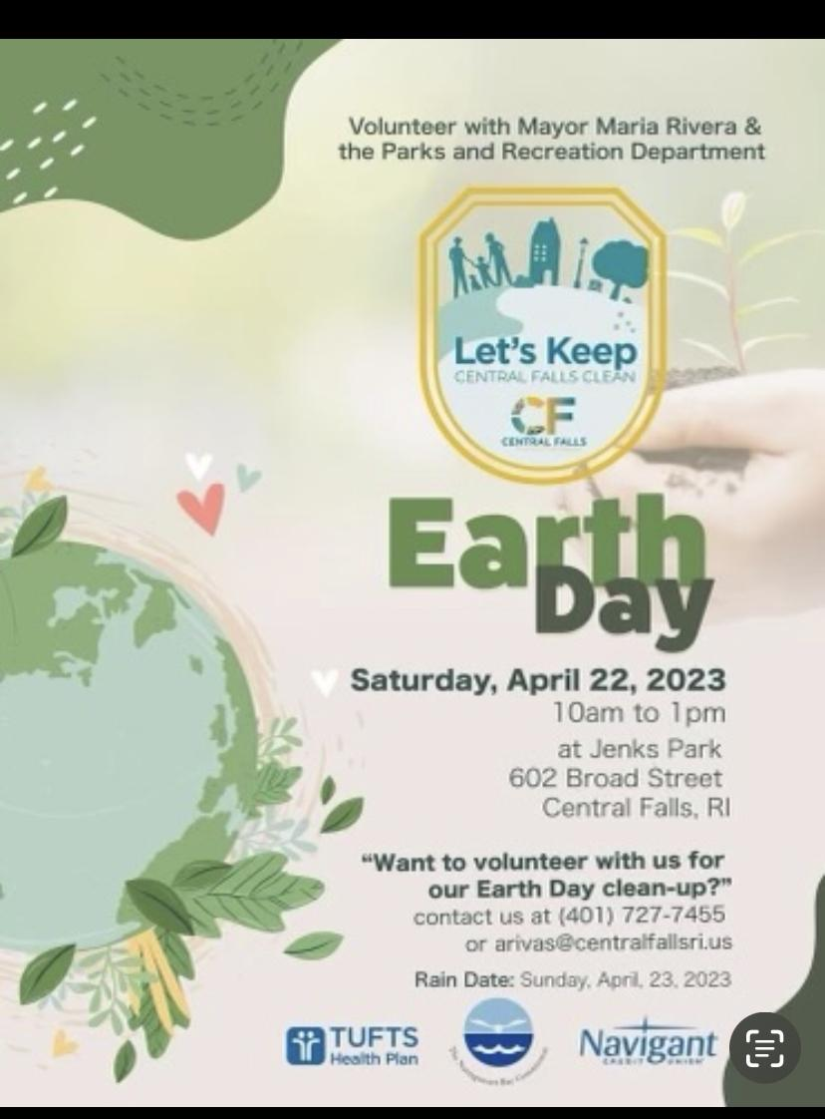
Advertisement/Recruiting
We created a posterboard and flyer we presented the poster board to the youth.
Put pics of flyer.

Slide 5
What went well/ What could’ve went differently
Vee’s POV:
What went well with my group was that everyone was participating
We cleaned up almost everything we could, the park genuinely looked better after we picked up the trash.
Lamisa’s POV:
Went well my group had 3 bag full and everyone followed the rules and engaged well
We also helped other groups clean up when we seem them, the park wasn’t as bad as the streets though

Slide 6
How much trash was picked up? (estimate)
We had 4 big black bags full of trash!!

Slide 7
What were the pieces of trash you collected the most? What was the most interesting piece of trash you collected?
Vee
We picked up mainly little liquor bottles and snack stuff
The most interesting yet disgusting piece was a condom.
Lamisa
The most things we picked up were cigarette boxes
The most interesting thing we picked up was a wine bottle

Slide 8
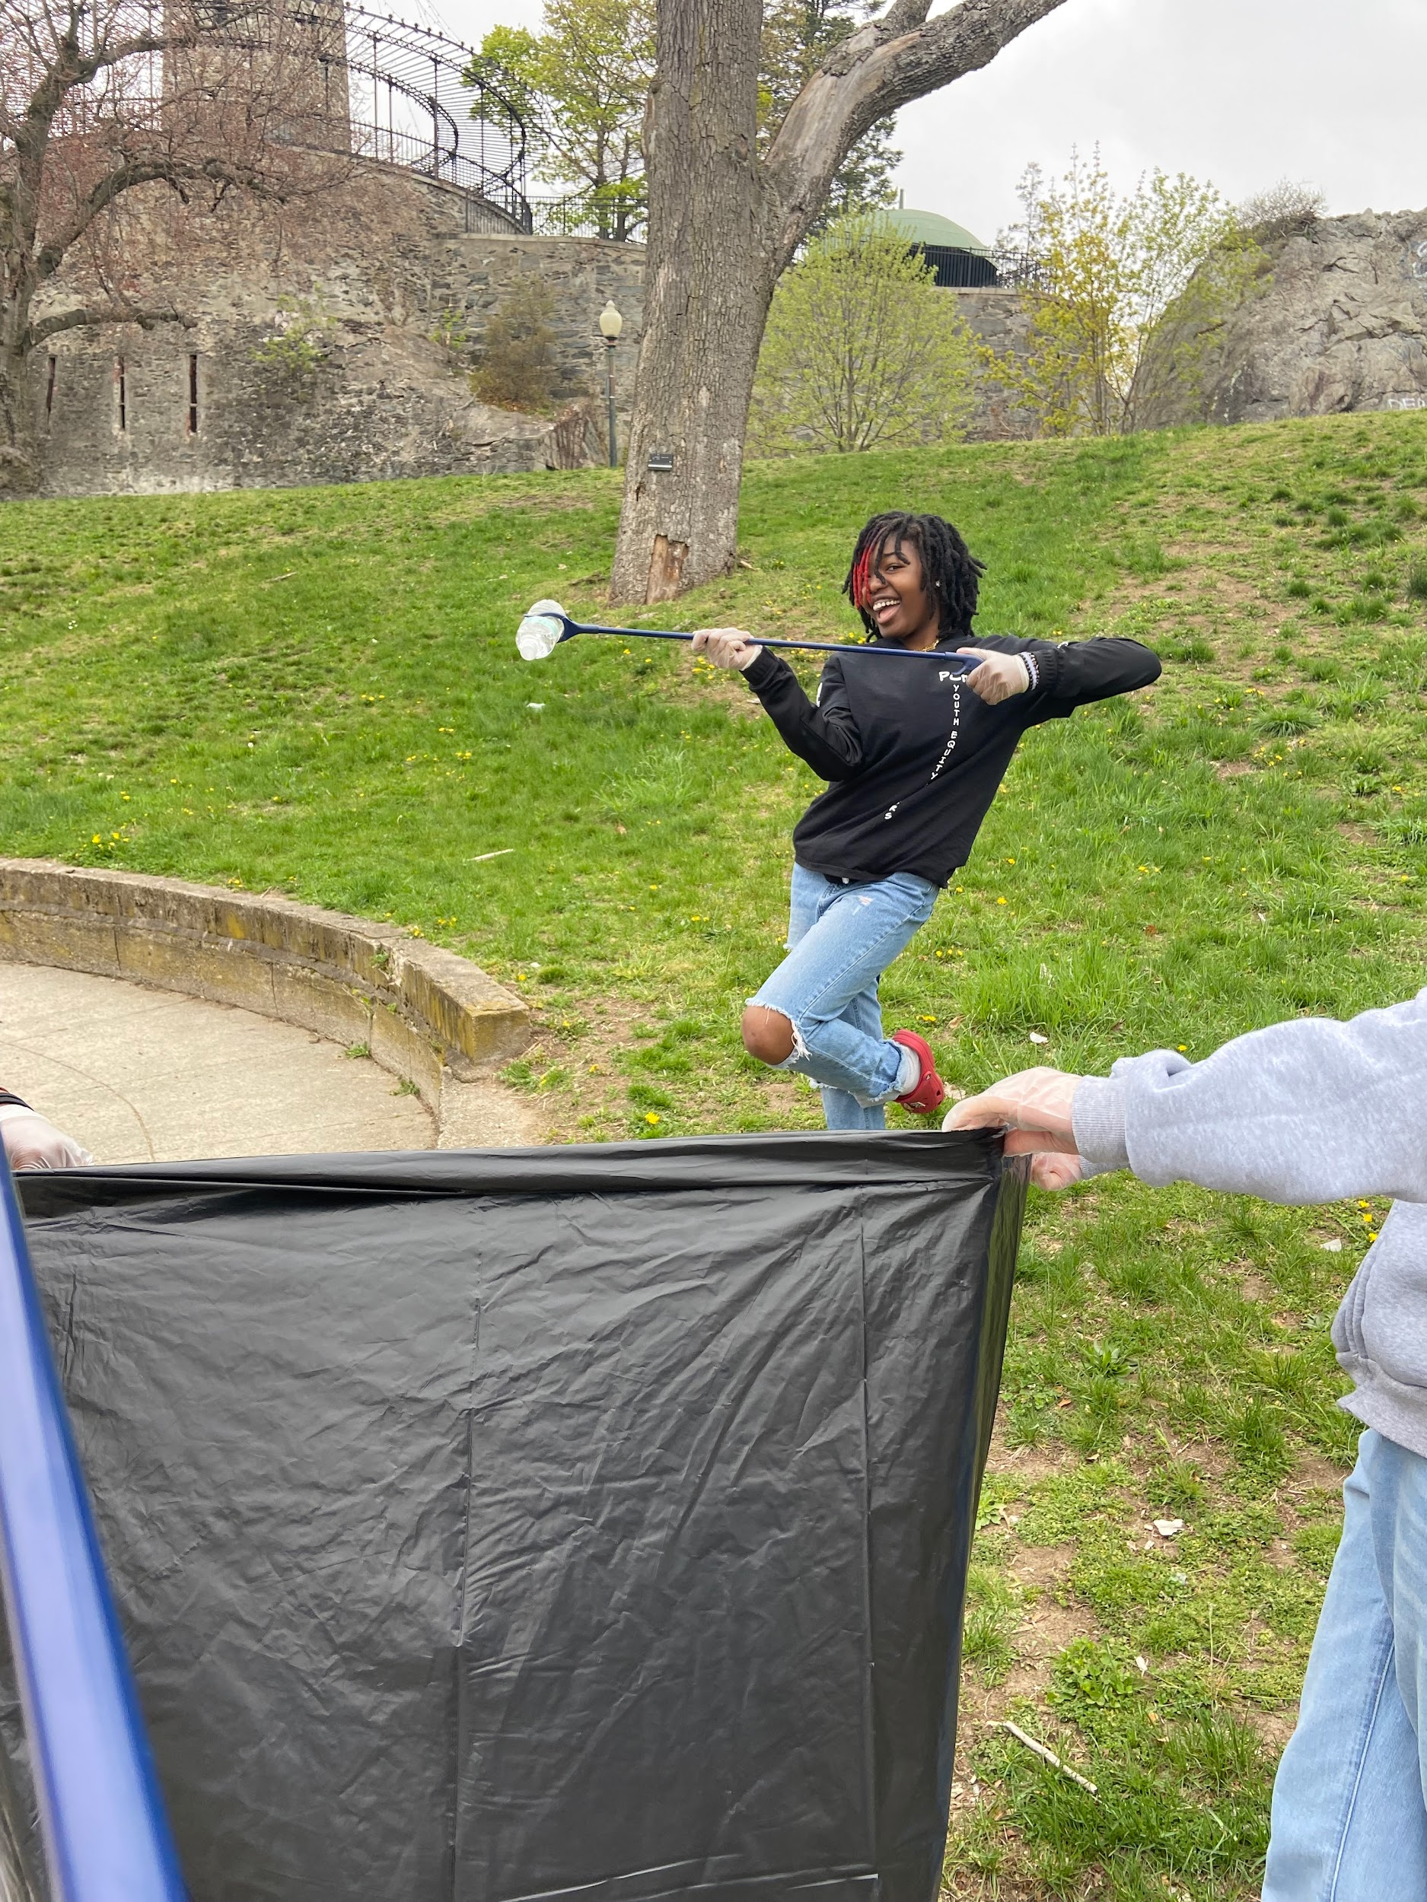
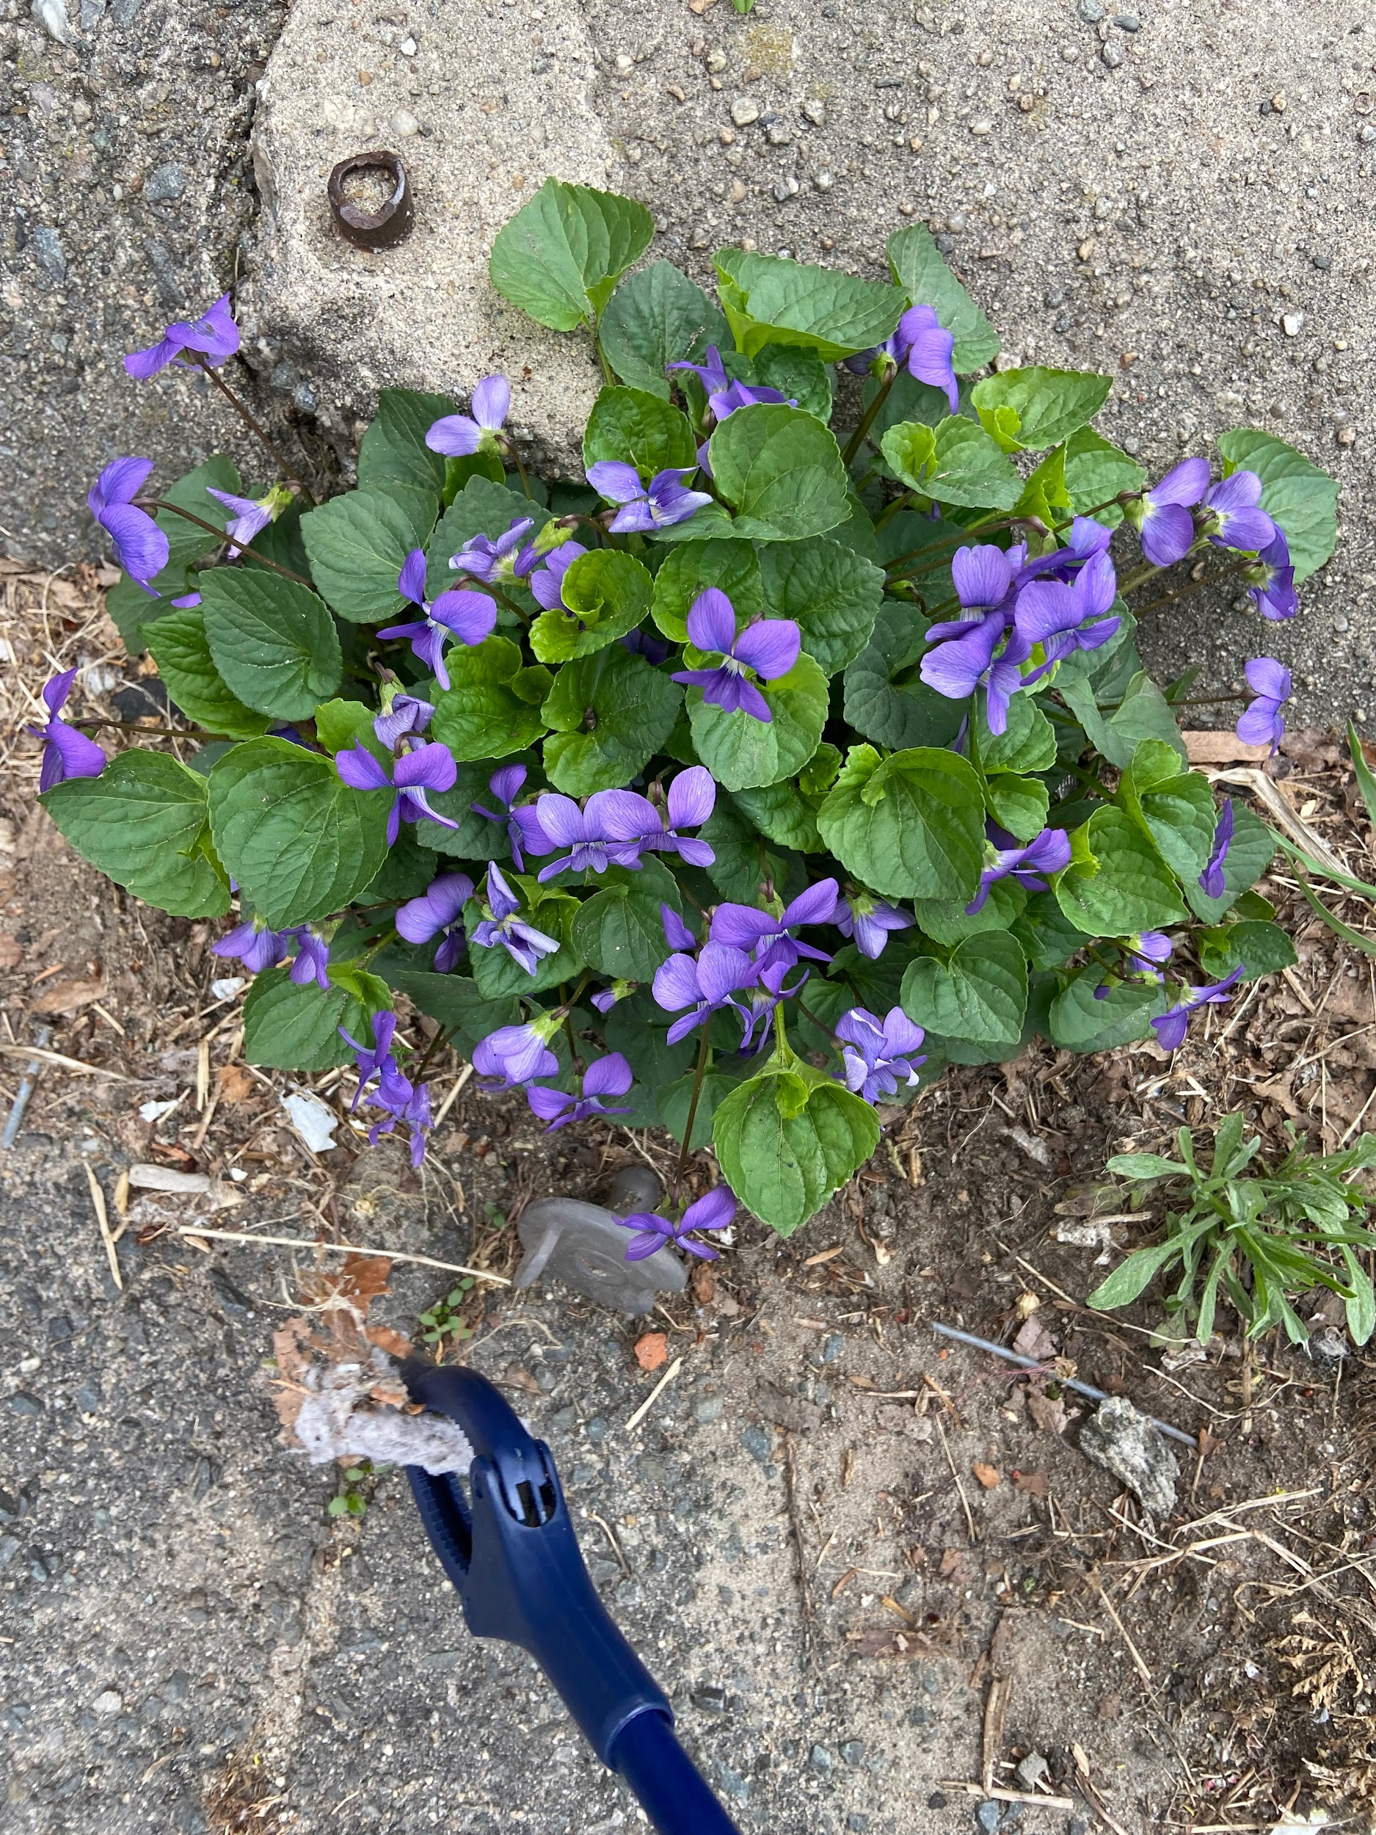
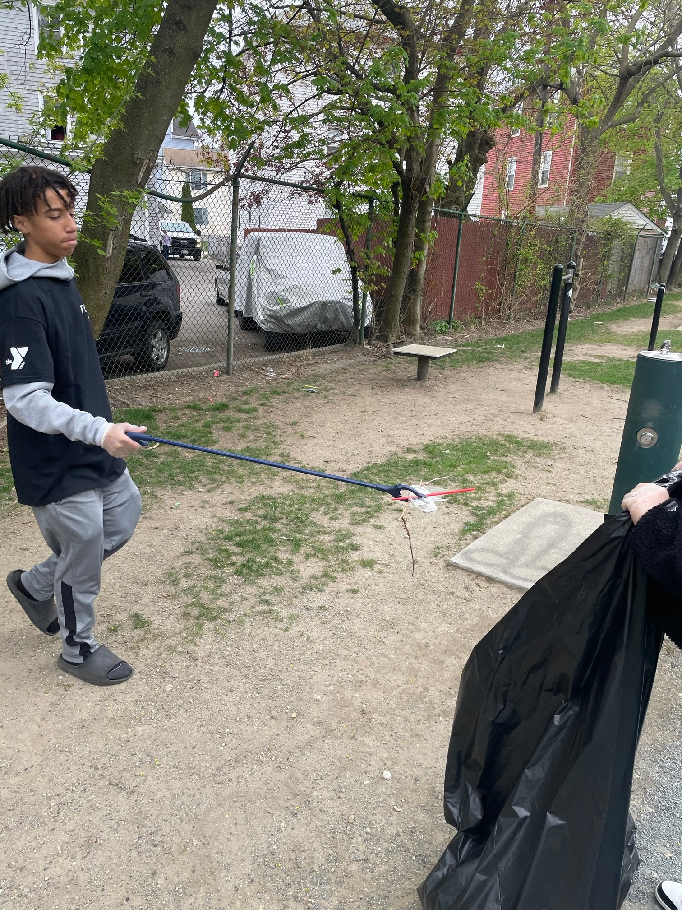
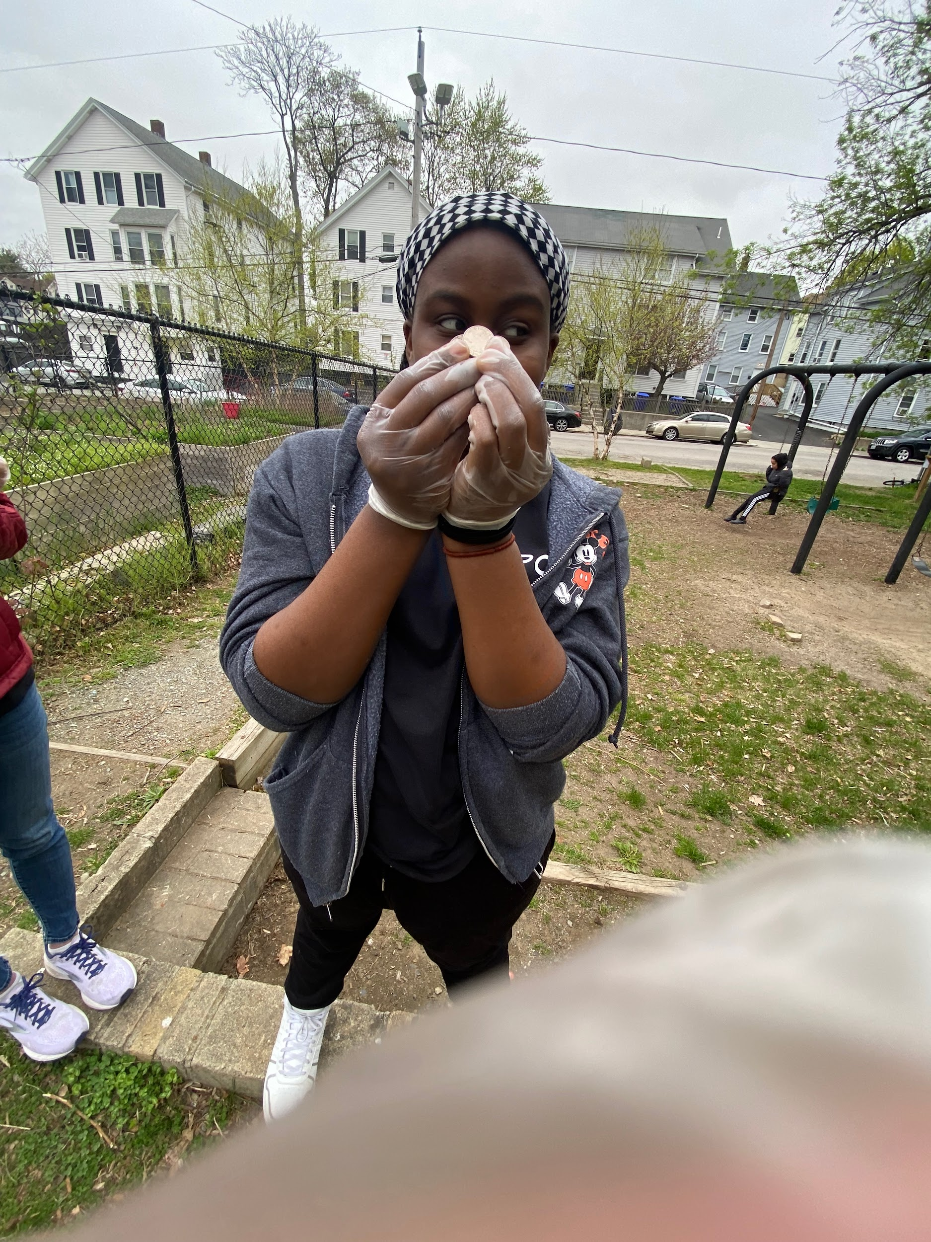
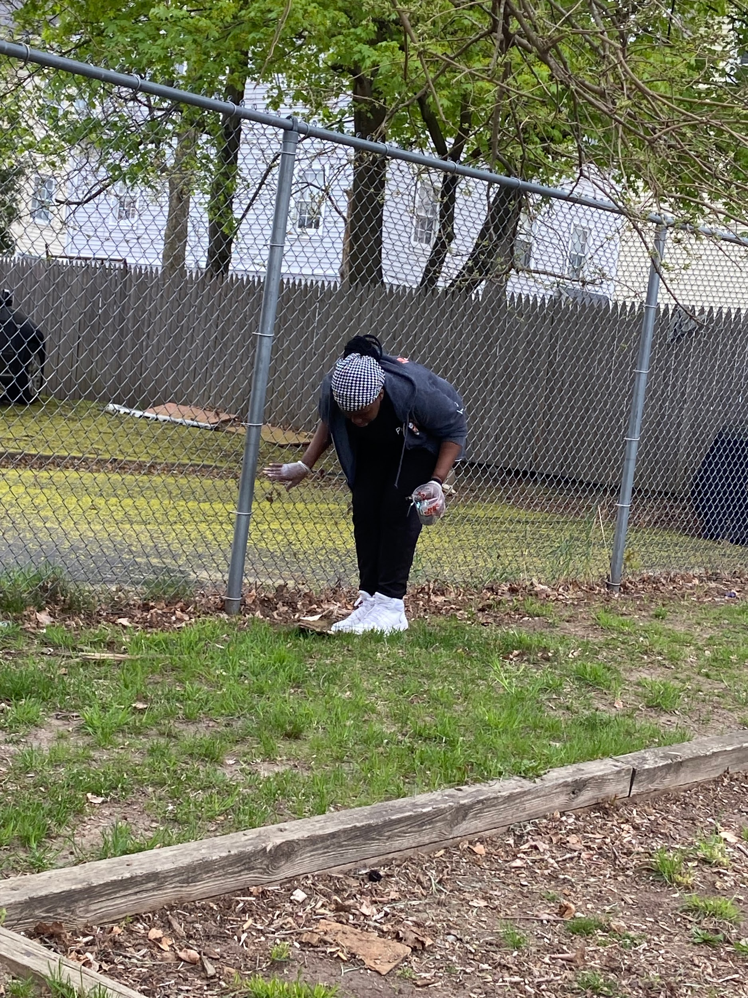
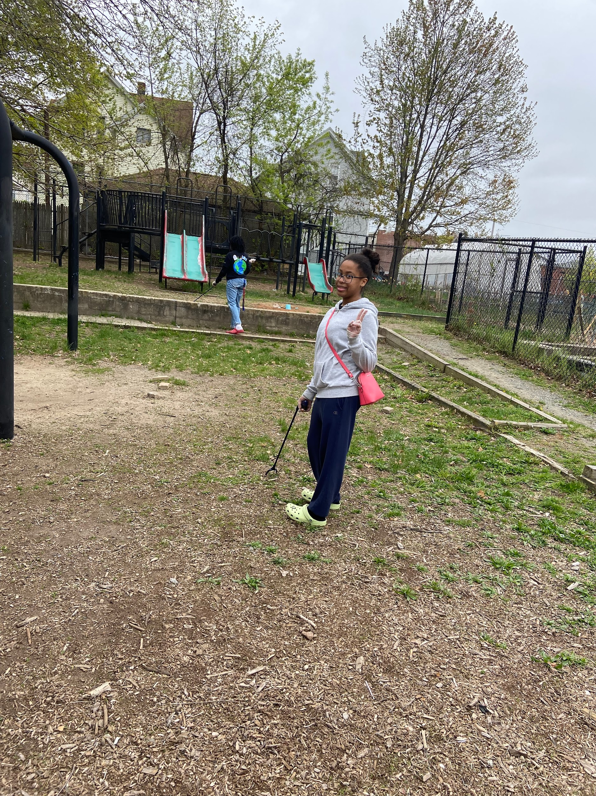
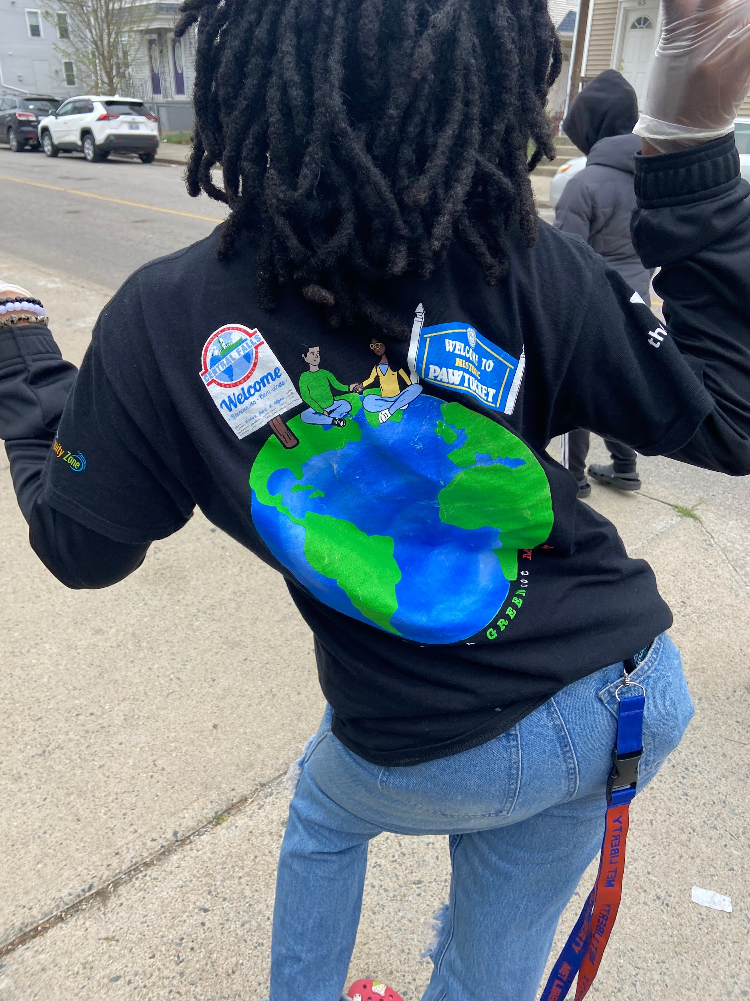
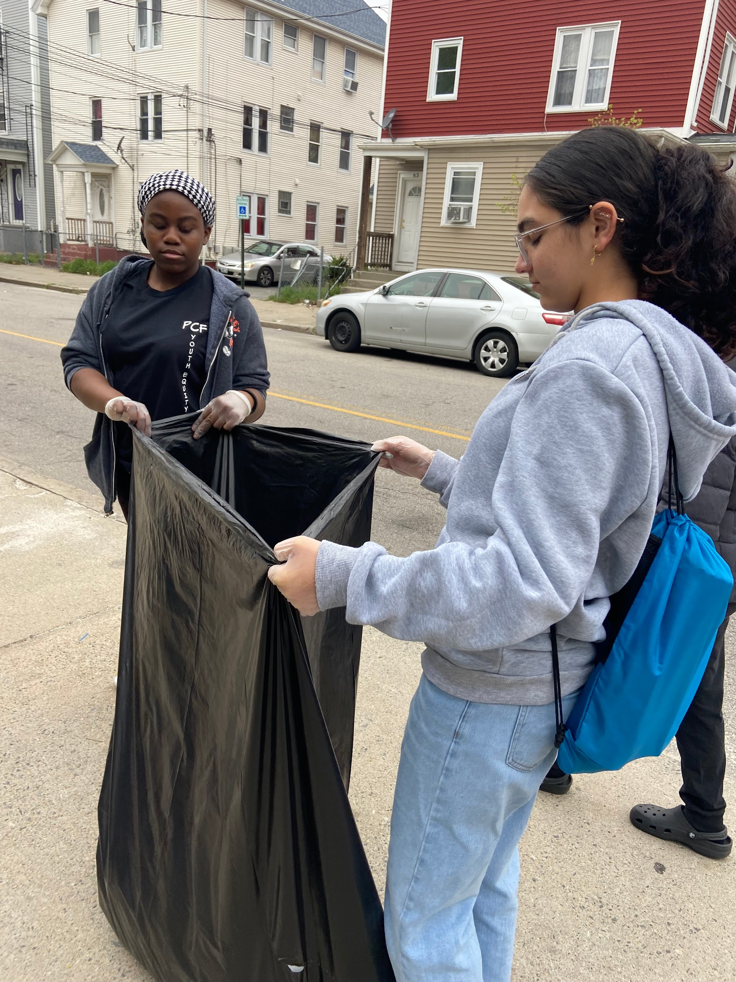
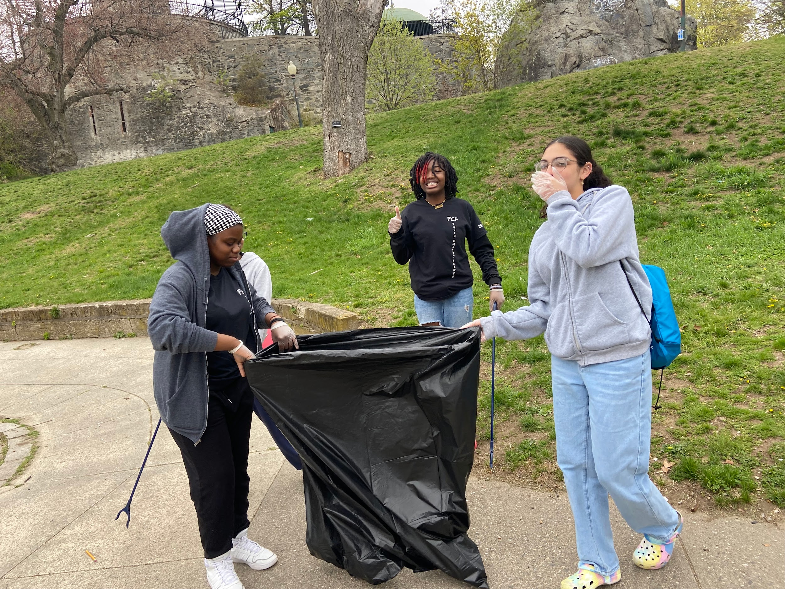

Slide 9
